Slide 1
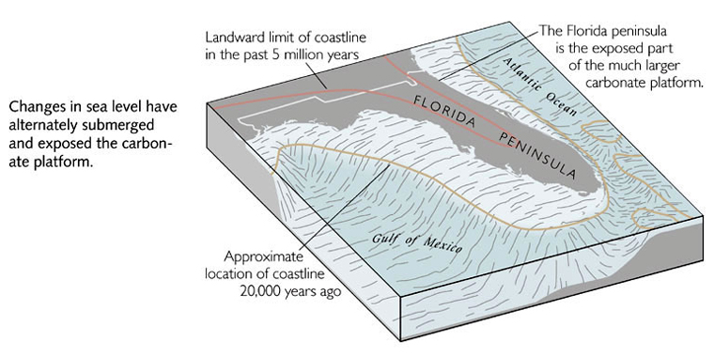
Notes:
During the interval when sea level dropped, runoff carved stream channels across the carbonate platform.

Slide 2
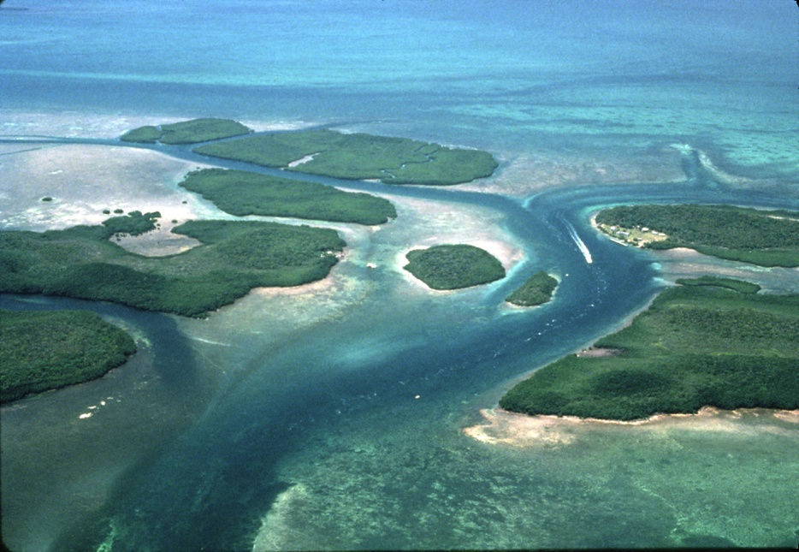
Relict stream channel through keys
bay
ocean
Notes:
When sea level rose, these submerged and became the relatively deep channels that now provide boaters with safe and easy passage across the keys.

Slide 3
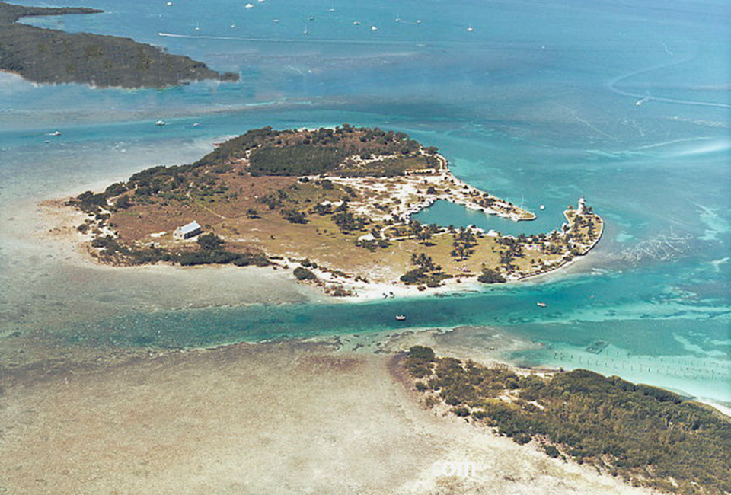
bay
Stream flow
Stream flow
ocean
Notes:
20,000 years ago streams flowed through such channels towards a shoreline that was more than 300 feet lower.

Slide 4
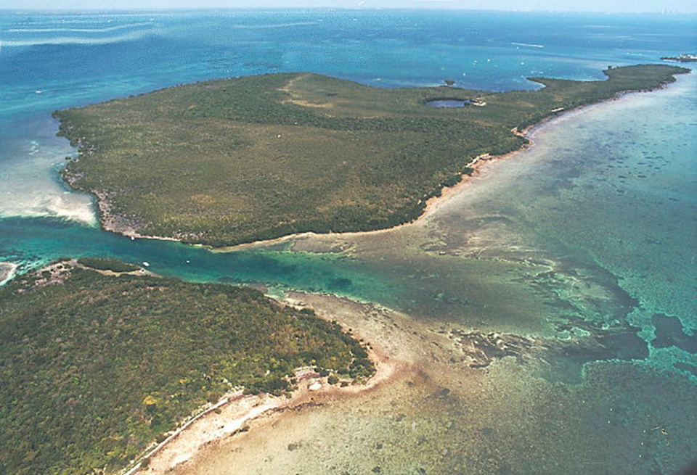
bay
TIDAL CURRENTS
ocean
Notes:
Today, tidal currents sweep sediment from the channels and deposit it in tidal deltas on both sides of the keys

Slide 5
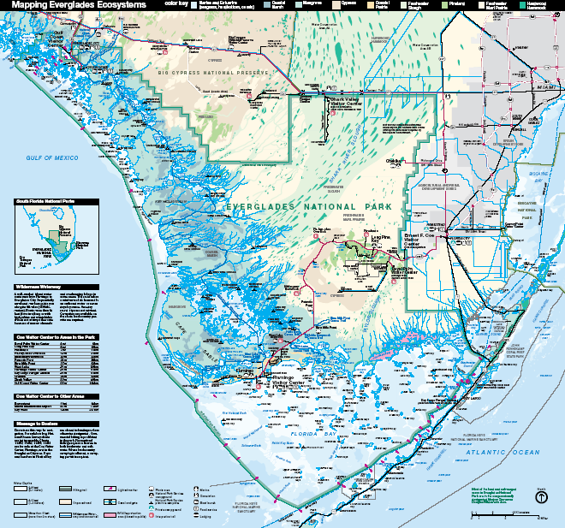
estuaries
Notes:
Where mainland runoff causes a lasting and significant reduction in bay side salinity, the bays can be called estuaries.

Slide 6
Holocene deposition (continued)
Marine - Estuarine
sand bars / shoals
sea grass meadows
Notes:
Since runoff is relatively nutrient rich, sea-grass meadows grow on estuarine sand bars and shoals.

Slide 7
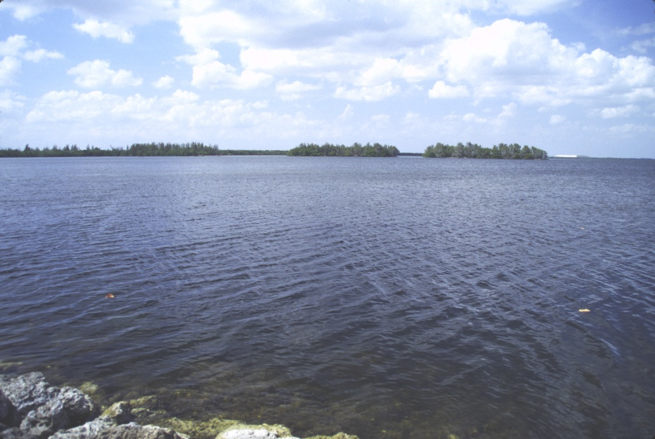
Biscayne Bay
Notes:
Fresh water influence and nutrient supply is especially great in Biscayne Bay because it is one of the most ocean-restricted of the estuaries.

Slide 8
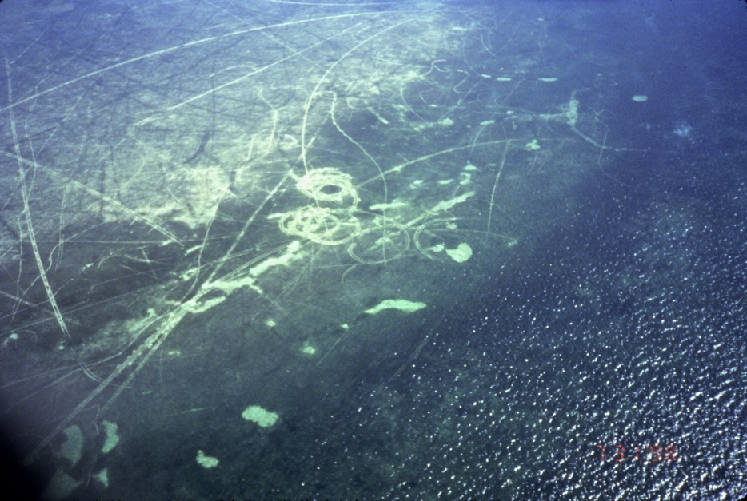
Boat damaged sea-grass meadows
Notes:
Thus, sea-grass meadows abound. Unfortunately, so do careless boaters.

Slide 9
EXPOSED
Notes:
In the more ocean-exposed parts of Florida Bay, fresh water influence and associated nutrient supply is minimized, while ocean currents become far more influential.

Slide 10
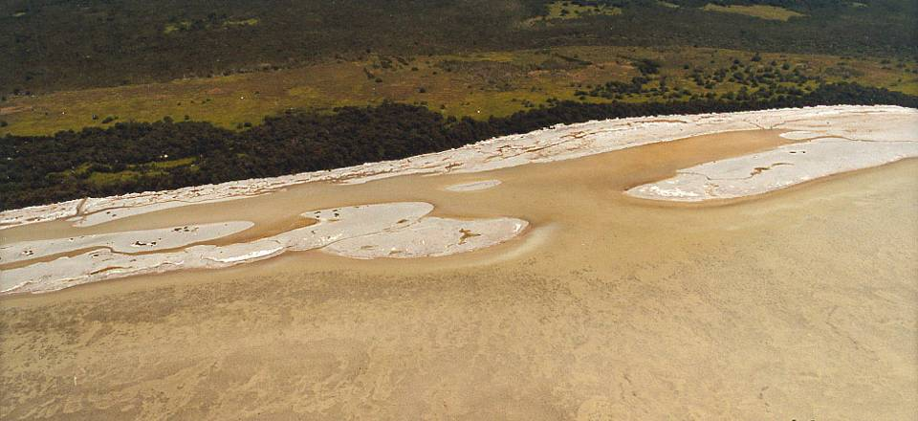
Shifting shoals on less protected northwest shore
Notes:
That results in barren, shifting shoals of carbonate sand.

Slide 11
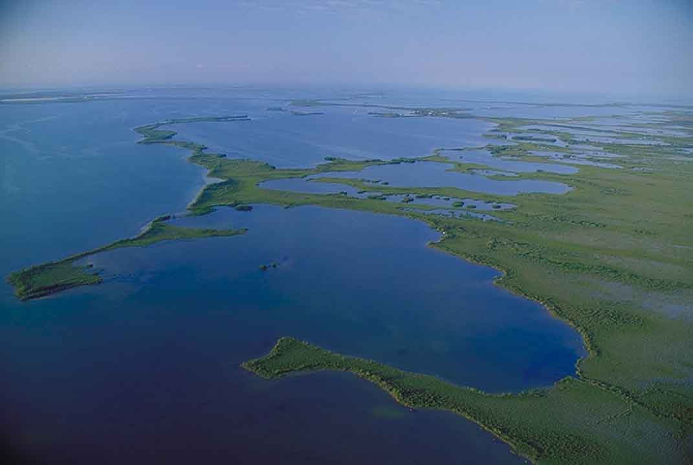
Florida Bay – marine/estuarine ecosystem
Notes:
In the most protected estuaries, complex depositional mechanisms create a maze of coastal features that make the term coastline useless, but give meaning to the term Netherlands.

Slide 12
sinkhole
Notes:
Much of the complexity results from submerged sinkholes, ….

Slide 13
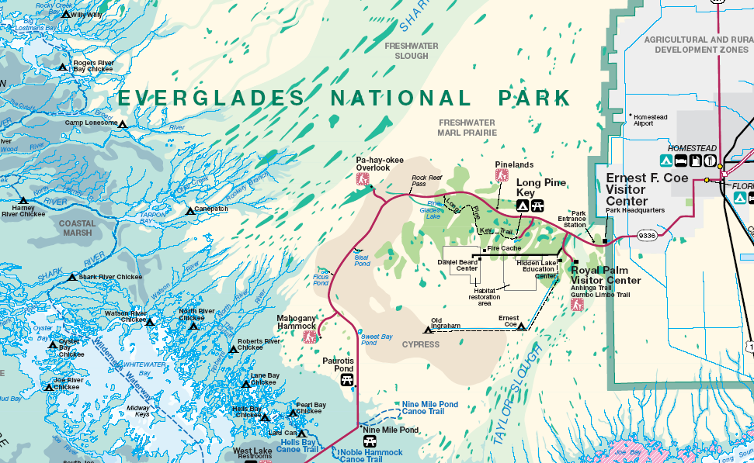
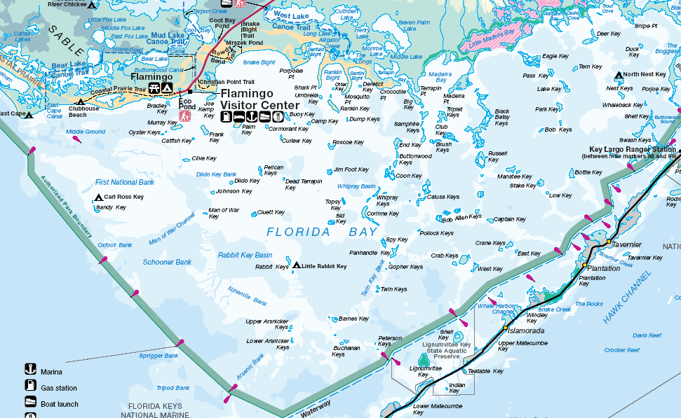
Notes:
… but the brackish estuarine waters are conducive to oysters, which form somewhat elongated, but mostly irregular beds between the sinkholes.

Slide 14
Holocene deposition (continued)
Marine - Estuarine
sand bars / shoals
sea grass meadows
sinkhole margins
oyster beds / true mangroves / glades
Notes:
Oyster beds provide a stable bottom for mangroves to gain a foothold on. Eventually the mangrove-populated areas become the “glades” which are ever-so-common in the Everglades.

Slide 15
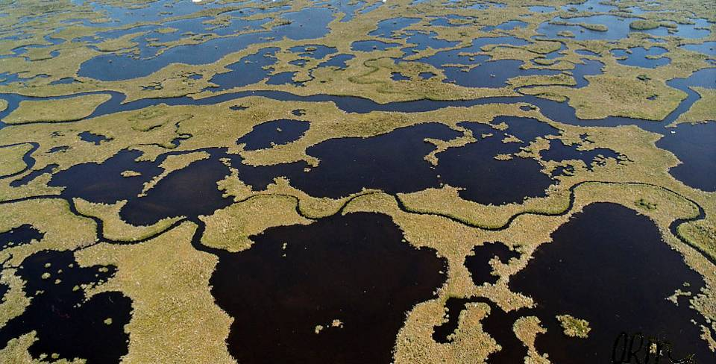
Pop quiz. Explain this landscape’s origin!
Notes:
Relax, I’m just kidding. But we are finally ready to make some sense of this mess.

Slide 16
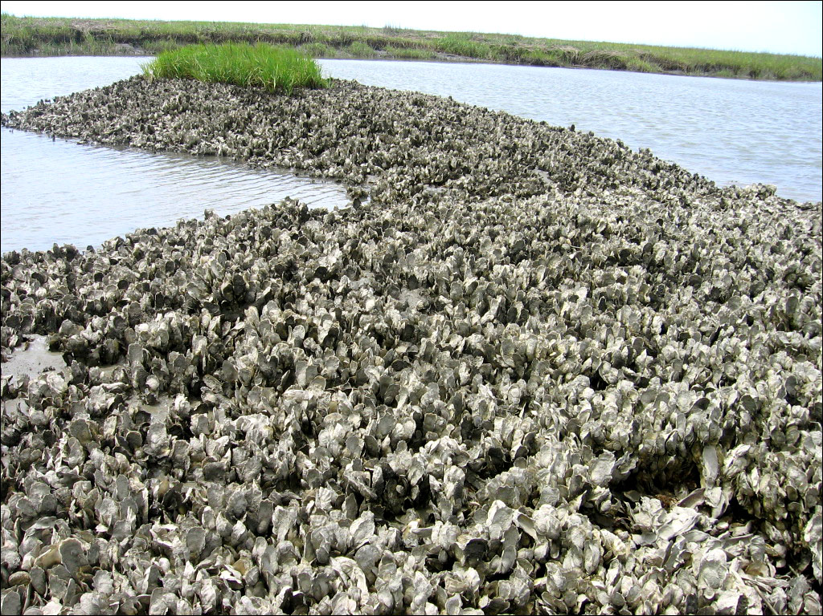
Notes:
First, oyster beds form on sinkhole margins. This large, mature bed is exposed at low tide, but it takes some time for an oyster bed to reach this size and thickness.

Slide 17
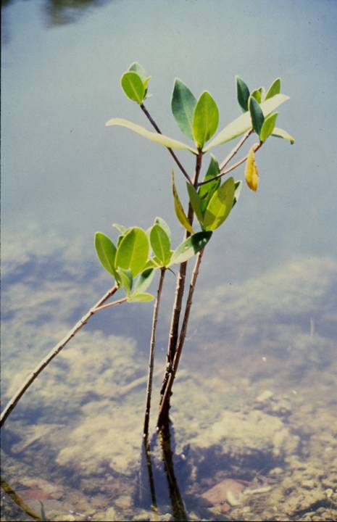
Mangrove seedling
Notes:
When the pile of oysters grows close enough to the surface, mangroves can take root

Slide 18
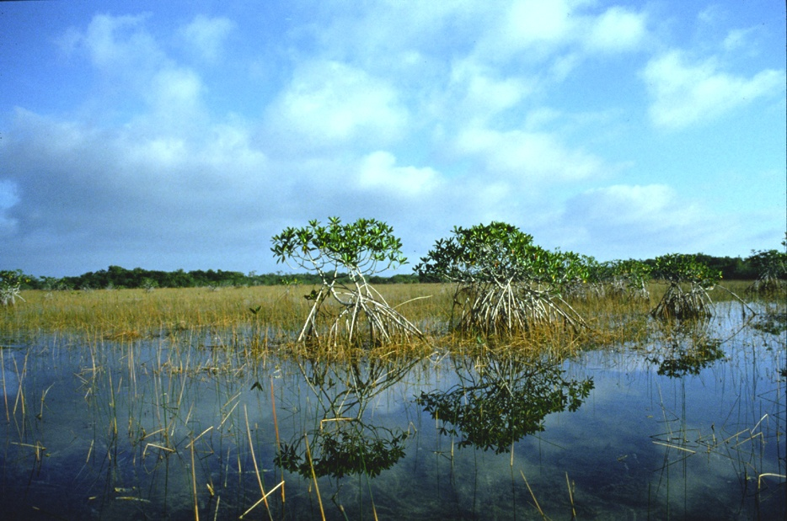
True Mangroves
SALT WATER
Notes:
True mangroves tolerate salt water, …

Slide 19
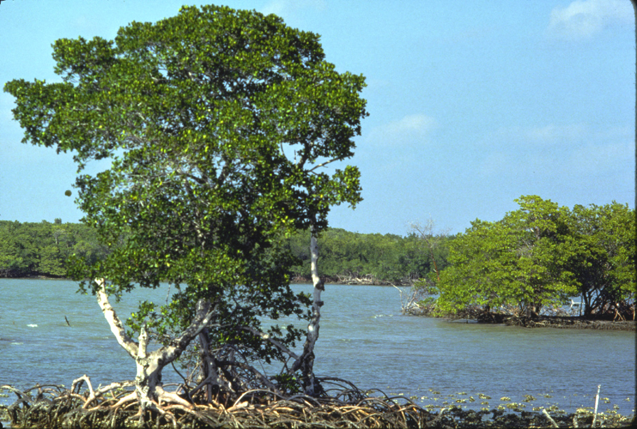
Roots elevate tree and provide salt tolerance
Notes:
… due in part to their stilt-like root systems which elevate most of the tree above sea level.

Slide 20
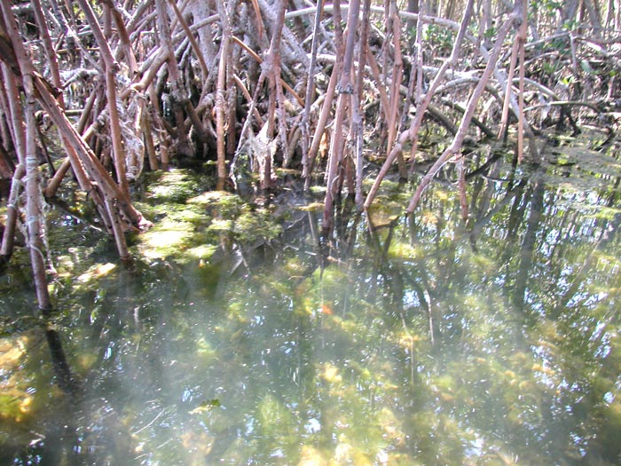
Notes:
As currents flow through the complex mangrove root system, …

Slide 21
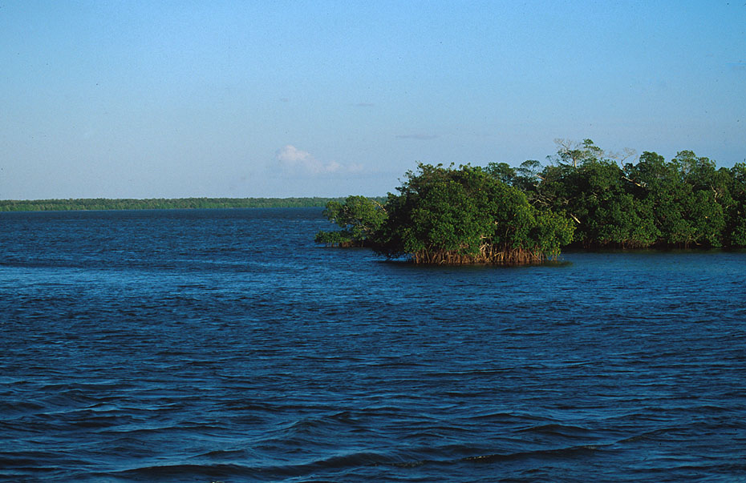
Mangrove roots slow currents and trap sediment
Notes:
… they slow down enough for suspended sediment particles to deposit under the mangroves.

Slide 22
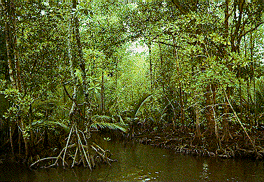
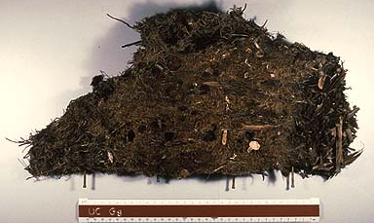
Mangrove hammock
Peat
Notes:
The root system also catches leaf litter falling from above, forming spongy, suspended peat mats known as hammocks.

Slide 23
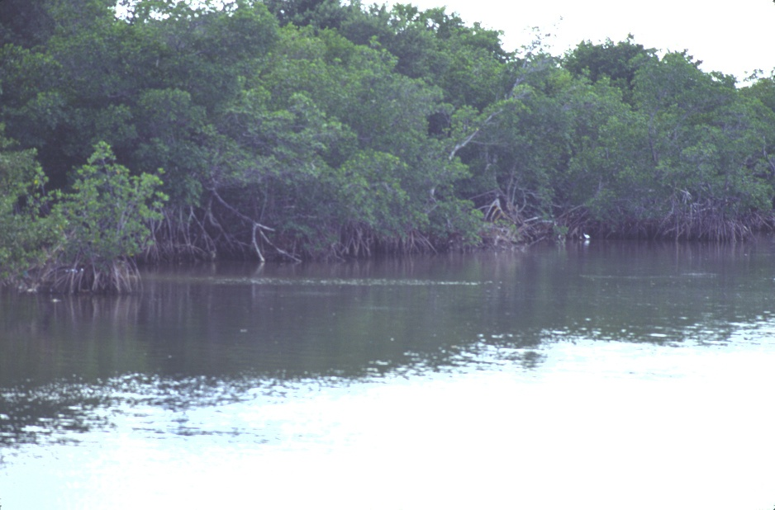
NEW LAND
Notes:
Eventually oysters, inorganic sediment and peat hammocks all combine to form new land.

Slide 24
brackish
fresher
Notes:
Although that new land is pretty saturated, it tremendously reduces the inflow of seawater relative to fresh water coming from land. When the ecology of the estuary changes from brackish water to something a lot closer to fresh water, …

Slide 25
Glades
True mangroves
Notes:
… true mangrove hammocks are replaced by treeless areas known as glades.

Slide 26
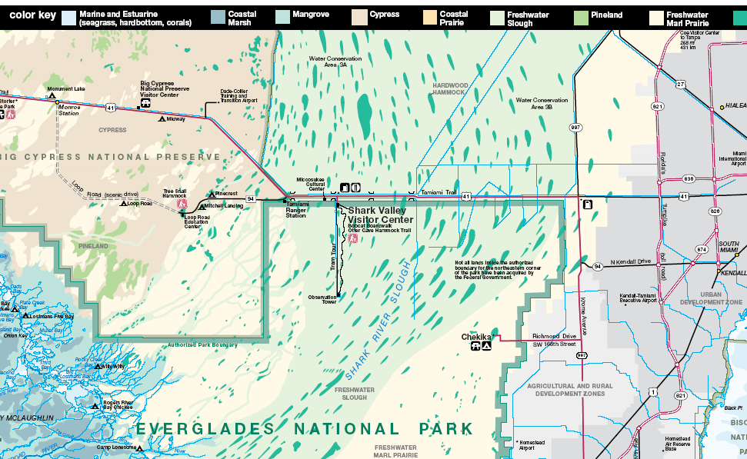
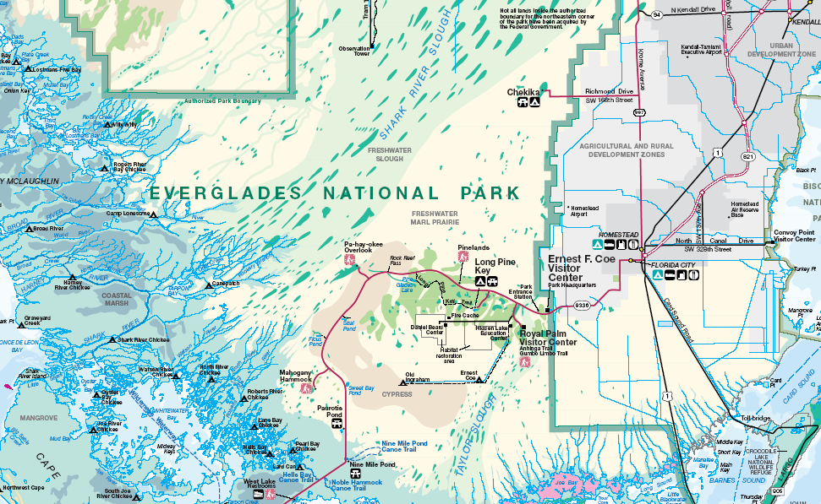
Notes:
Although true mangroves only grow near salt or brackish water, several other types of trees may form hammocks within the glades. In this part of the world, the term slough is used to describe the broad depressions that crudely channelize runoff and consist of both glades and hammocks.

Slide 27
Holocene deposition (continued)
Sloughs
fresh water hammocks
peat
glades
marl
Notes:
Two types of deposition occur in the sloughs. Peat forms from fresh water hammocks and a limey mud called marl deposits throughout the glades.

Slide 28
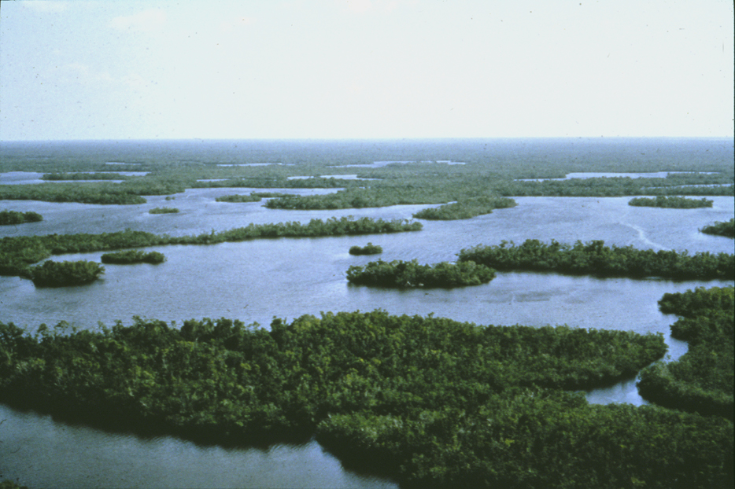
Snake River Slough and false mangrove hammocks
Notes:
Whether hammocks or glades form in the slough is determined by the length of time the area stays wet.

Slide 29
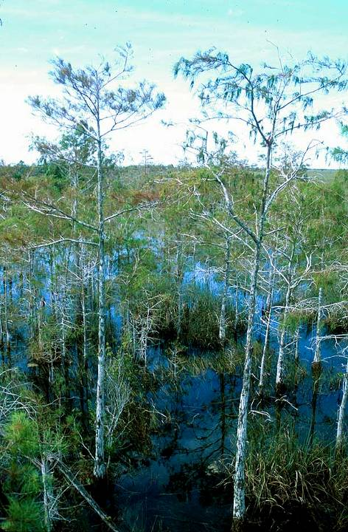
Notes:
Since the decomposition of organic material is far faster in air than water, peat tends to accumulate much faster in wet areas …

Slide 30
Mangrove hammock
Peat
Notes:
… eventually forming hammocks slightly elevated above the water level.

Slide 31
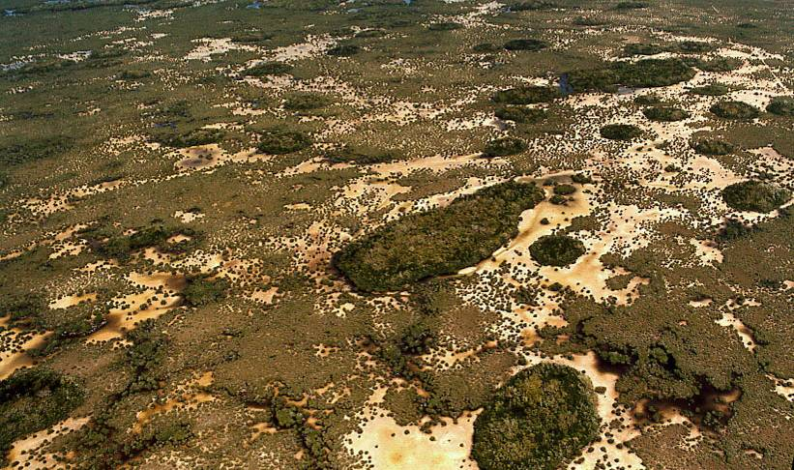
Mahogany hammock in dry season
No peat forms
Notes:
If dry conditions last more than about 3 months out of the year, then virtually all that year’s organic detritus will decompose and no peat can form.

Slide 32
Mahogany hammock in dry season
Standing water
Notes:
If you look closely you can see a little water pooling around some of the hammocks, inhibiting dry-season decomposition and ensuring that some organic material will survive so that peat can accumulate.

Slide 33
Mahogany hammock in dry season
Marl deposits
Notes:
Where peat does not accumulate, usually marl does.

Slide 34
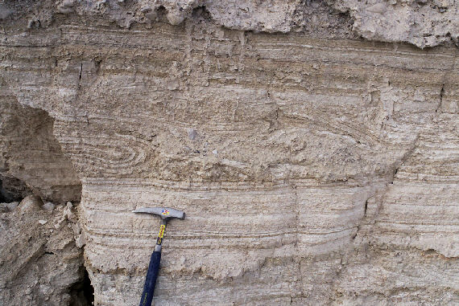
Marl (mud + lime)
Notes:
Marl is a mixture of lime and mud …

Slide 35
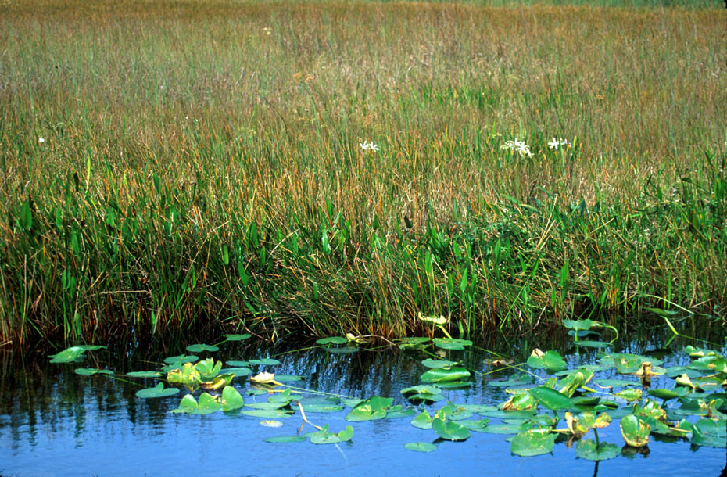
Wet season glade in Shark River Slough
Notes:
… which in the Everglades generally forms in glades. That’s because during the wet season a calcareous algae encrusts the submerged portions of most glade plants.

Slide 36
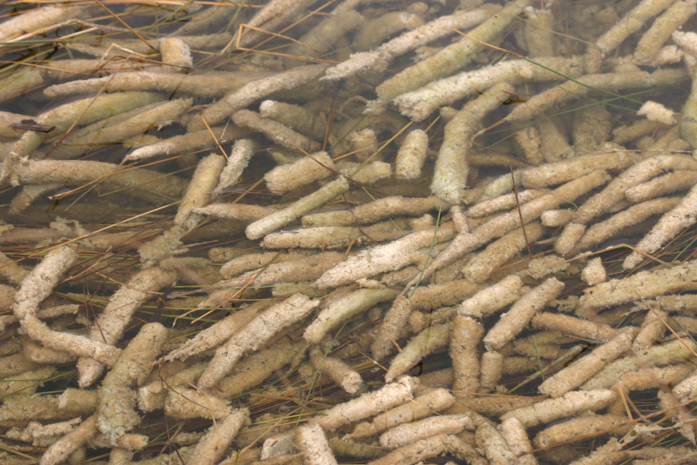
Periphyton
Notes:
Although dominantly made of calcareous algae, the sausage-sized encrustations (periphyton) are a complex mixture of algae, microbes and detritus.

Slide 37
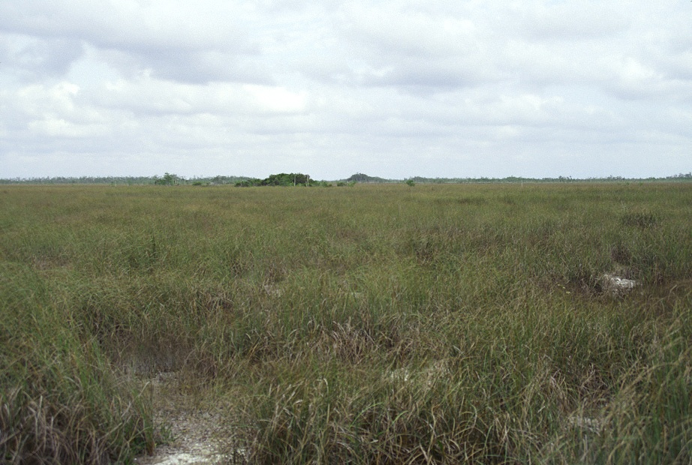
Dry season glade in Shark River Slough
Marl deposits
Notes:
The crusty mixture ends up settling beneath virtually the entire glade along with …

Slide 38
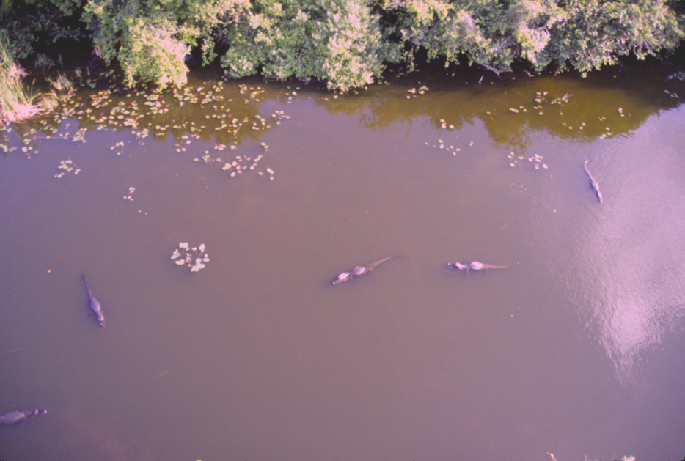
Suspended clay and decomposed organics
Notes:
… clay and decomposed organic matter formerly suspended in the sloughs. The baby gators are my cue to wrap this up now.

Slide 39
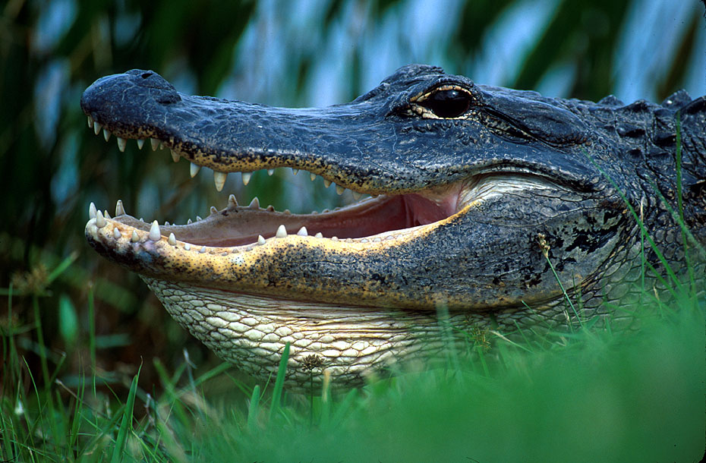
Bye now!
Notes:
So in closing, I hope you understand now why flatness does not necessary imply geologic simplicity. On the contrary, complex depositional environments often form in flat areas because they are extremely sensitive to changes in sea and fresh water levels.

Slide 40
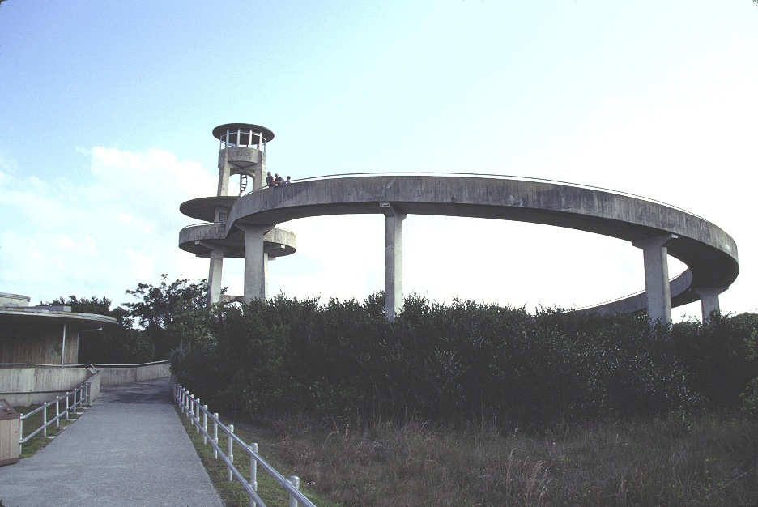
Notes:
Shark River Observation Tower

Slide 41
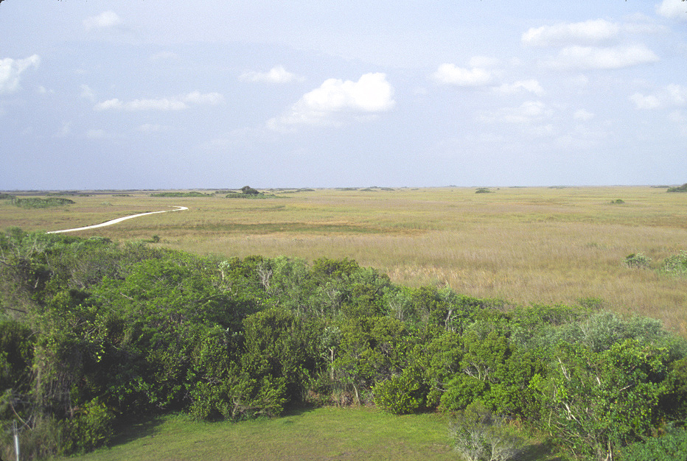
Notes:
Shark River Slough from Observation Tower

Slide 42
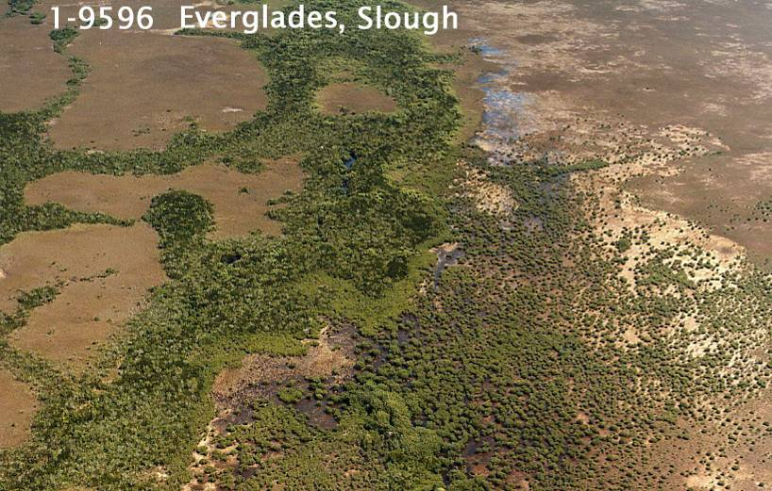

Slide 43
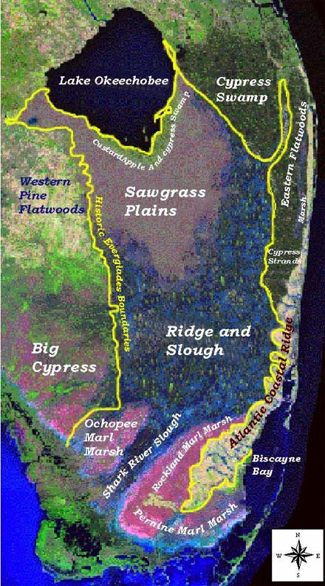

Slide 44
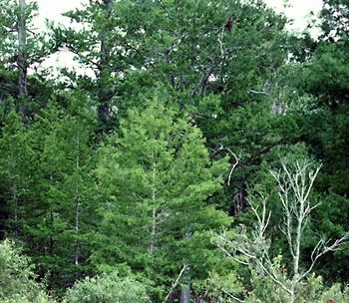
Pinelands/hardwood hammocks

Slide 45
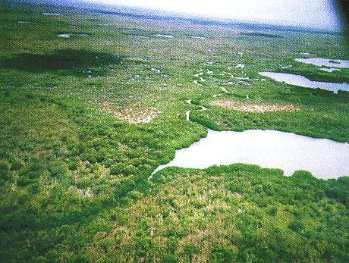
Taylor Slough
Notes:
Taylor slough

Slide 47
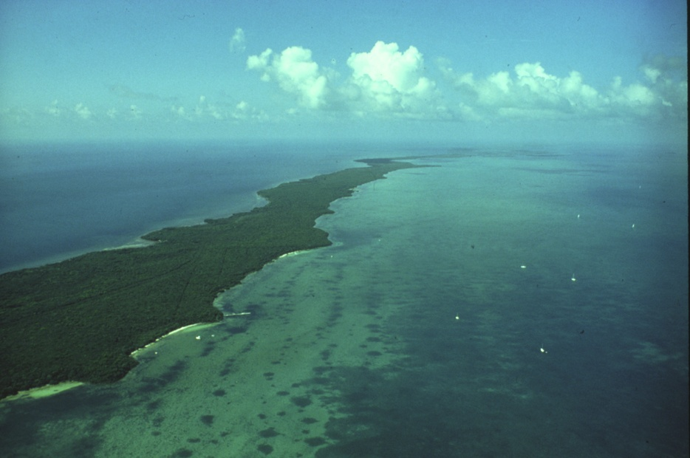
ocean
bay
Elliot Key
Notes:
Biscayne 10NPS Aerial-South along Elliot Key

Slide 48
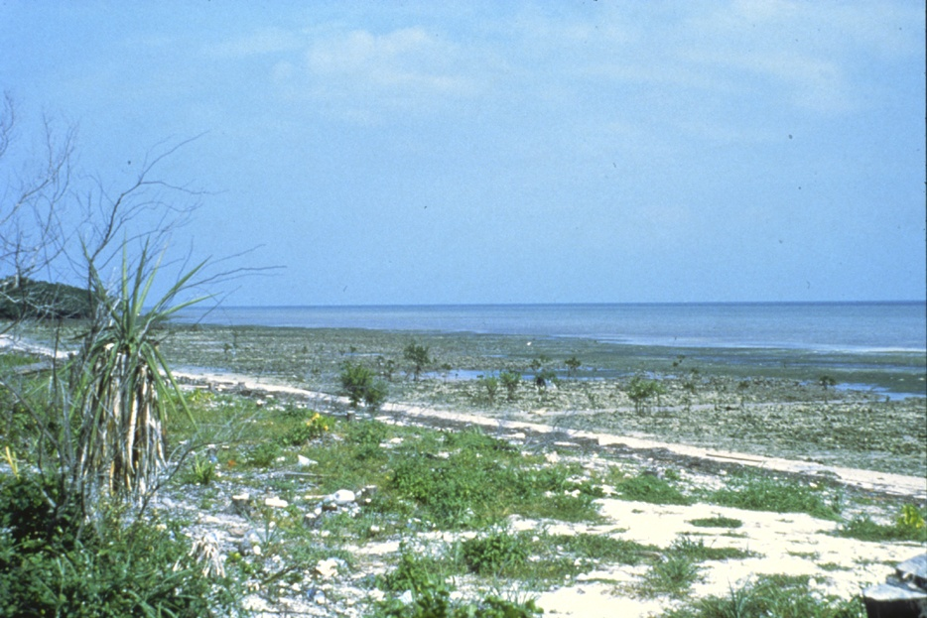
Biscayne Bay from Elliot Key
Notes:
Biscayne 01NPS Bayside, Elliot Key

